Slide 1
Linear Regression

Slide 2
Linear Regression
Regression is the analysis of the relation between an independent and one or more dependent variable assuming a linear relation.
In Linear Regression the idea is to fit a line that is the best fit to data.
The technique to fit the best line is called Least Square Method.
Least square method is a process to fit a curve to set of data by reducing the distance between actual value and predicted value.
The distance b/w actual value & predicted value is called Error.

Slide 3
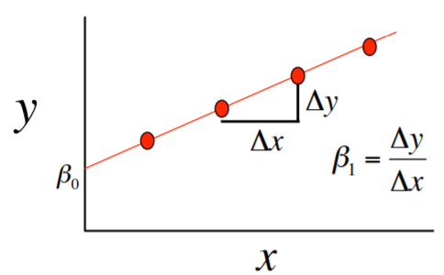
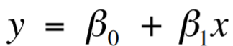
Linear Regression
Mathematically,

Slide 4
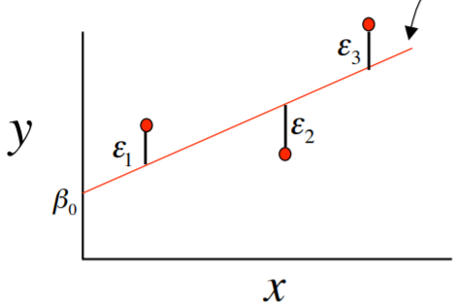
Linear Regression
Error Calculation,

Slide 5
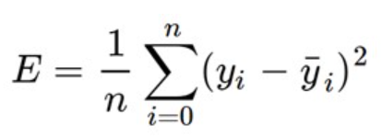


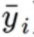
Loss Function
The loss is the error in the predicted value of m and c in the eq. y=mx+c
The loss is calculated using Mean Squared Error (MSE)
Total number of Samples
i^{th} instance of true value
i^{th} instance of predicted value
We have defined the loss function, In order to get the best fit line we need to minimize it.

Slide 6
How to reduce the cost function?
To minimize the loss function we need to get the optimum value of m and c such that the error is reduced.
Initially let us start m and c at 0.
we update their value iteratively such that the loss function is minimized.
Once the cost function is minimized the m and c values will be optimum and the prediction made using those m and c value will give the best fit line.

Slide 7
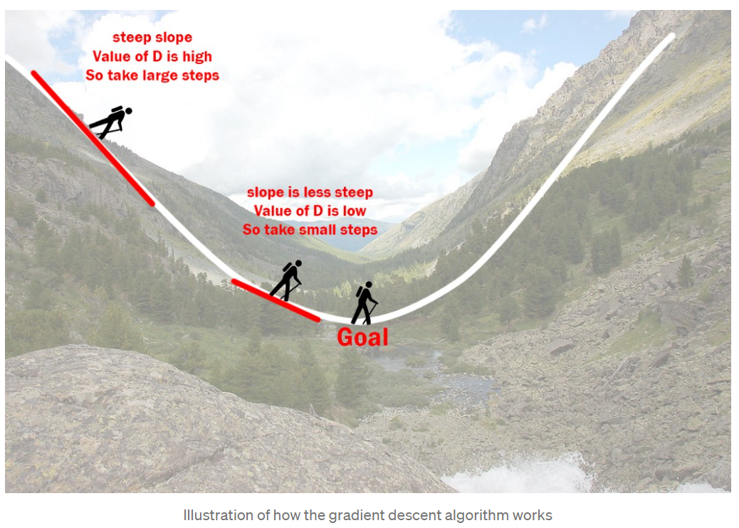
The Gradient Descent
The gradient descent is an optimization algorithm which is used to train the models.

Slide 8
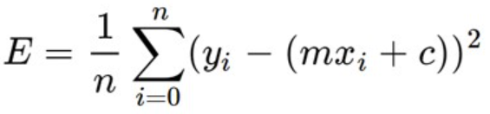
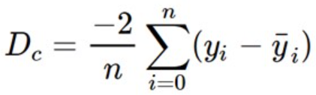
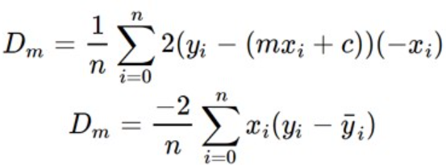
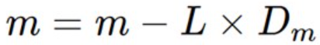
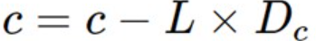
The Gradient Descent
Let L = Learning rate, determines how much m changes
Now we will calculate the derivative of Loss function wrt m and c.

Slide 9
The Gradient Descent
Let L = Learning rate, determines how much m changes
Now we will calculate the derivative of Loss function wrt m and c.

